Slide 1
CHALLENGE: ILLEGAL VENUES
TERESA PLATT
Sept 11, 2020

Slide 2
CHALLENGE FOR COUNTY: ILLEGAL VENUES
Protect County residents from illegal venues/party houses
  Fire, traffic, parking issues, water quality, COVID transmission
  Decline in property values (and tax revenues), quality of life
  Loss of income for legal venues with MUPs and restaurants
  Protect County from lawsuit risk related to illegal venues

Slide 3
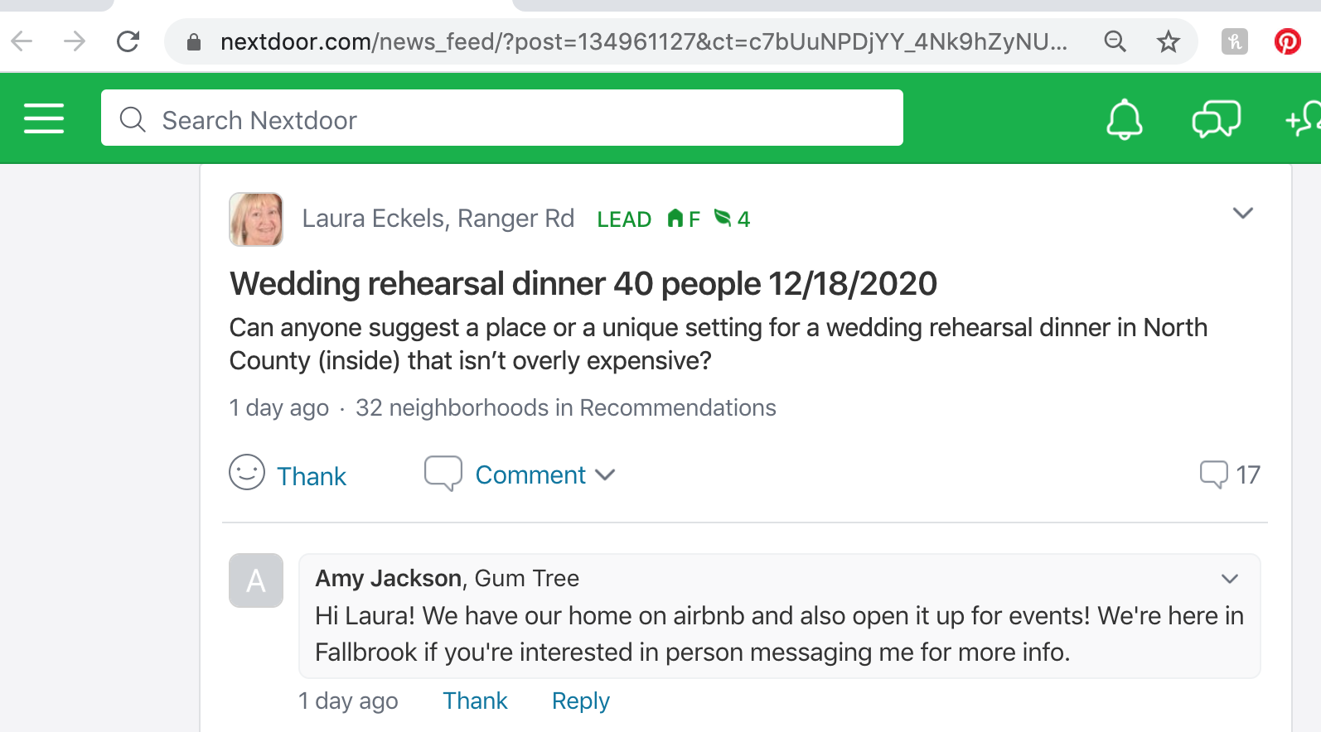
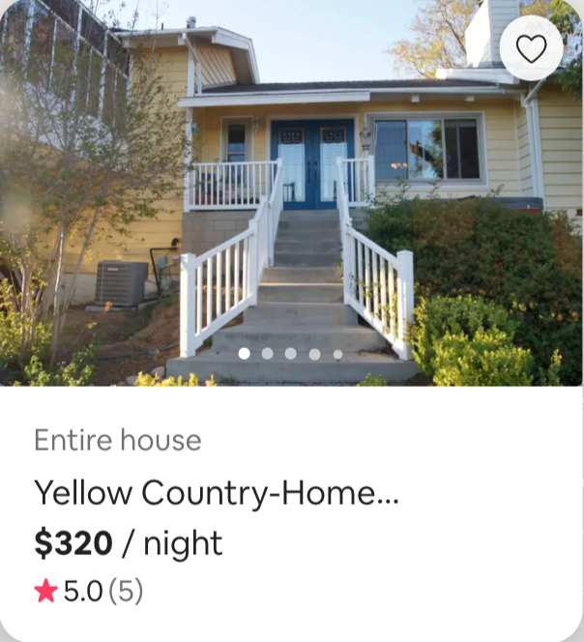
TRANSITION: RENTALS TO COMMERCIAL EVENTS

Slide 4
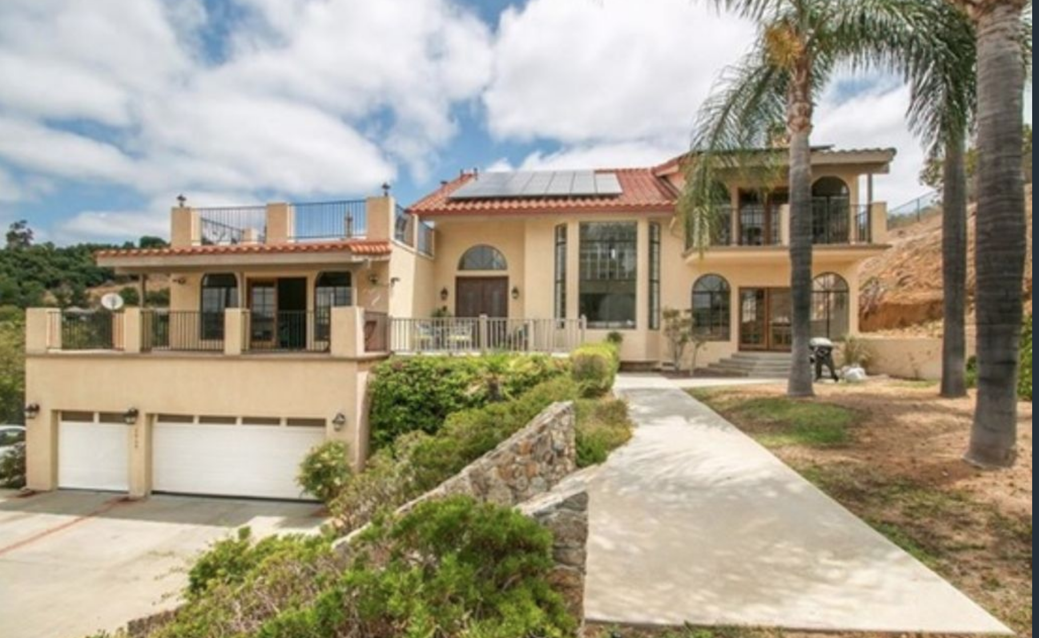
ILLEGAL EVENT VENUE, NUISANCE/PARTY HOUSE:
2808 LAKEMONT DRIVE
Ultimate Serenity Vacation Rental , www.airbnb.com/rooms/18864938, www.vrbo.com/1090108
8500 sq. ft. house and pool with absentee owners
2016: Announced plan to contract for large events and weddings
  Warned about need for Major Use Permit (MUP)
  Ignored the warning, moved forward with illegal business model
ILLEGAL VENUE

Slide 5
ILLEGAL EVENT VENUE, NUISANCE/PARTY HOUSE:
2808 LAKEMONT DR
2017: Crossed line from short term rentals to illegal venue/party house:
  Weddings, reunions, parties, corporate events, summer camps for children
  Neighbors complained re: traffic, parking, noise
  Neighbor’s house sold at a discount due to “nuisance house” next door
2018: Neighbors Campaign to “Shut Down The Party House”
  Engaged County Zoning, Sheriff, Dept. of Env. Health, Sup Desmond, etc.
  Created archive for documents and complaints
Fall-2019: After warnings and fines, 2808 no longer hosting weddings
January 2020: 2808 promoting corporate retreats and large events
May 2020: During COVID lockdown, 2808 hosts party for 200+
  Organized by four Marines from Camp Pendleton

Slide 6
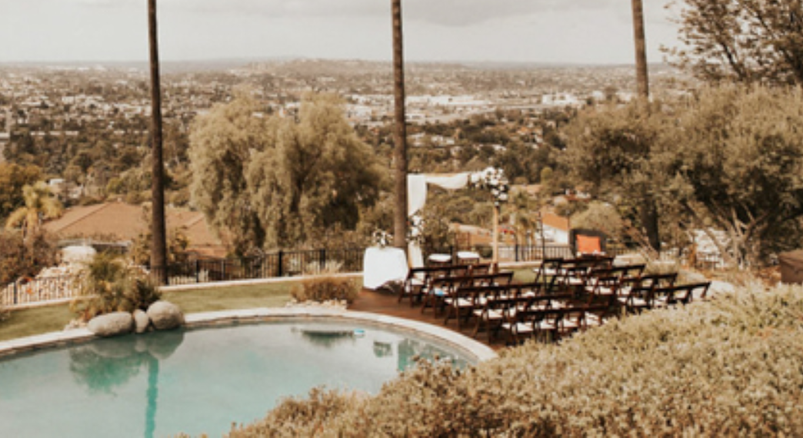
junebug weddings promotes weddings at Airbnbs in residential neighborhoods
“This Stunning San Diego Airbnb Mansion Wedding Proves You Don’t Need a Traditional Venue for Your Big Day” July 2019
Coordinated by Timeless Event Planning
Ocean View Estate, Airbnb #13114061
ILLEGAL VENUE
Mt. Helix Airbnb #13114061

Slide 7
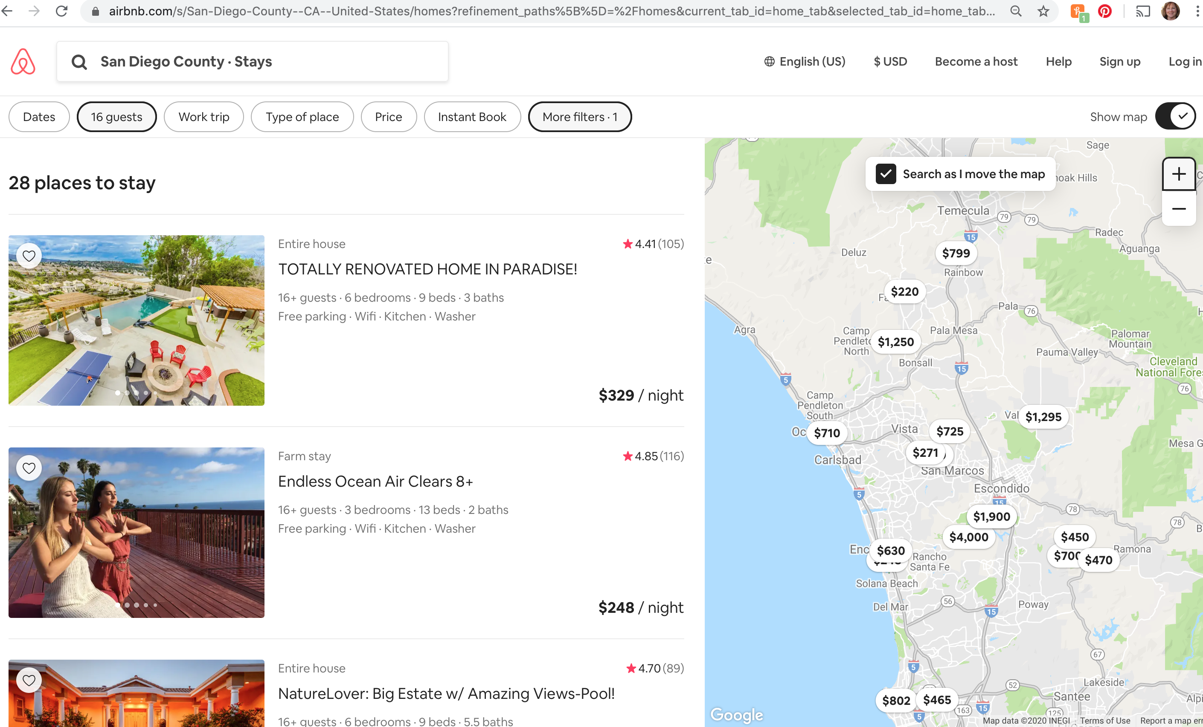
North San Diego County Airbnb’s w/16 guests, events allowed, 28 hitS

Slide 8

PEERSPACE: TRAVEL + LEISURE ADVISES
ILLEGAL VENUES

Slide 9
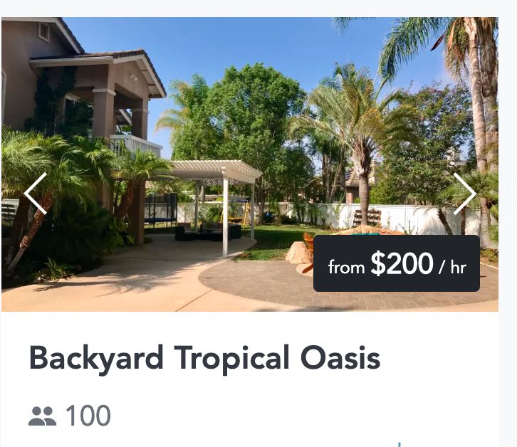
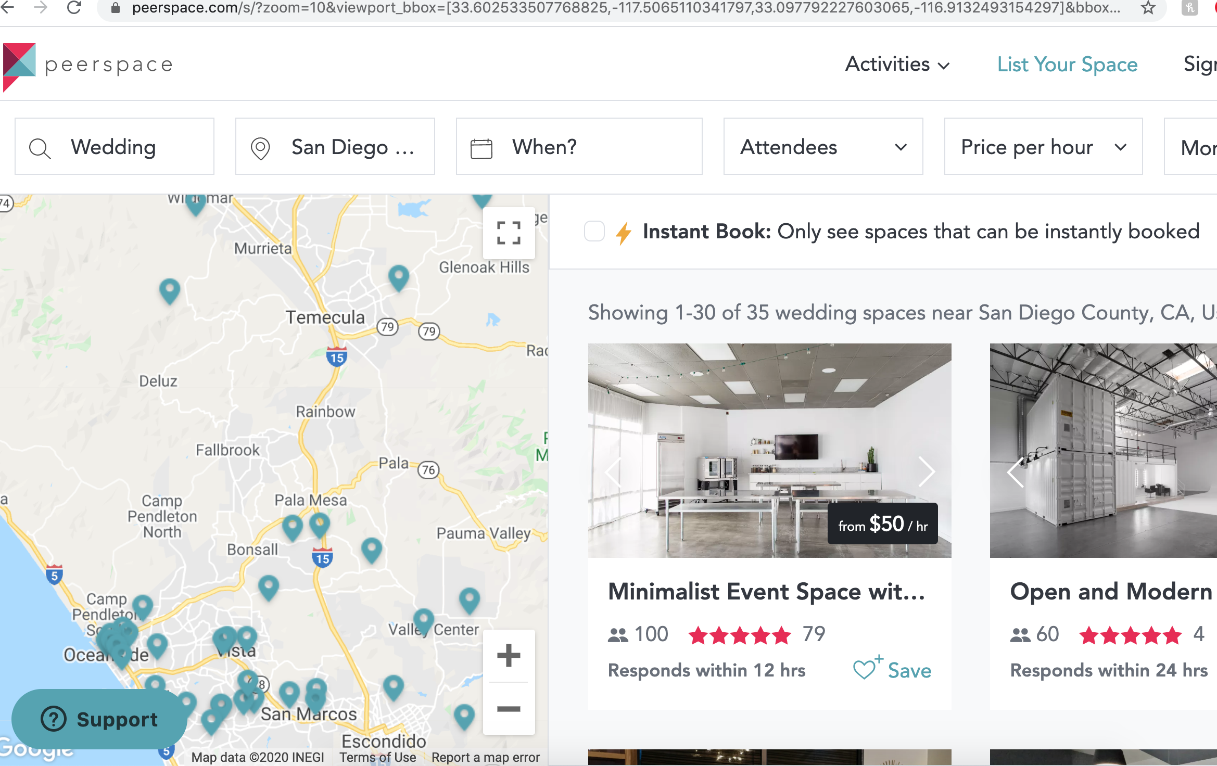


Peerspace: NORTH SD County, 35 hits
Escondido
ILLEGAL VENUES
Bonsall
Temecula

Slide 10
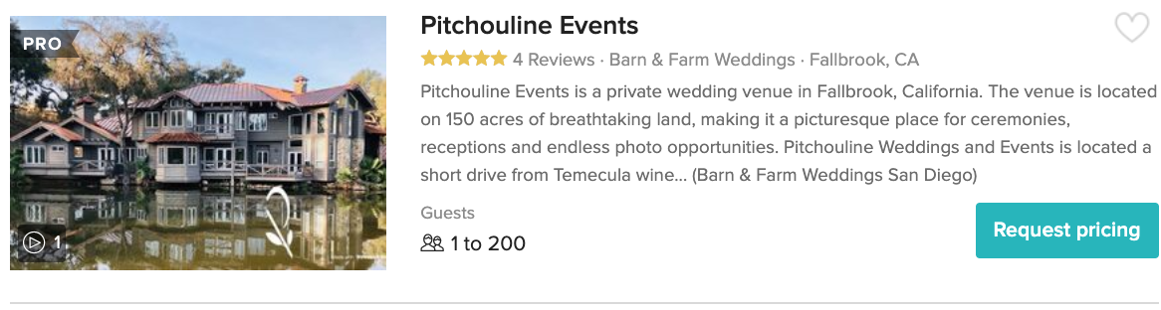
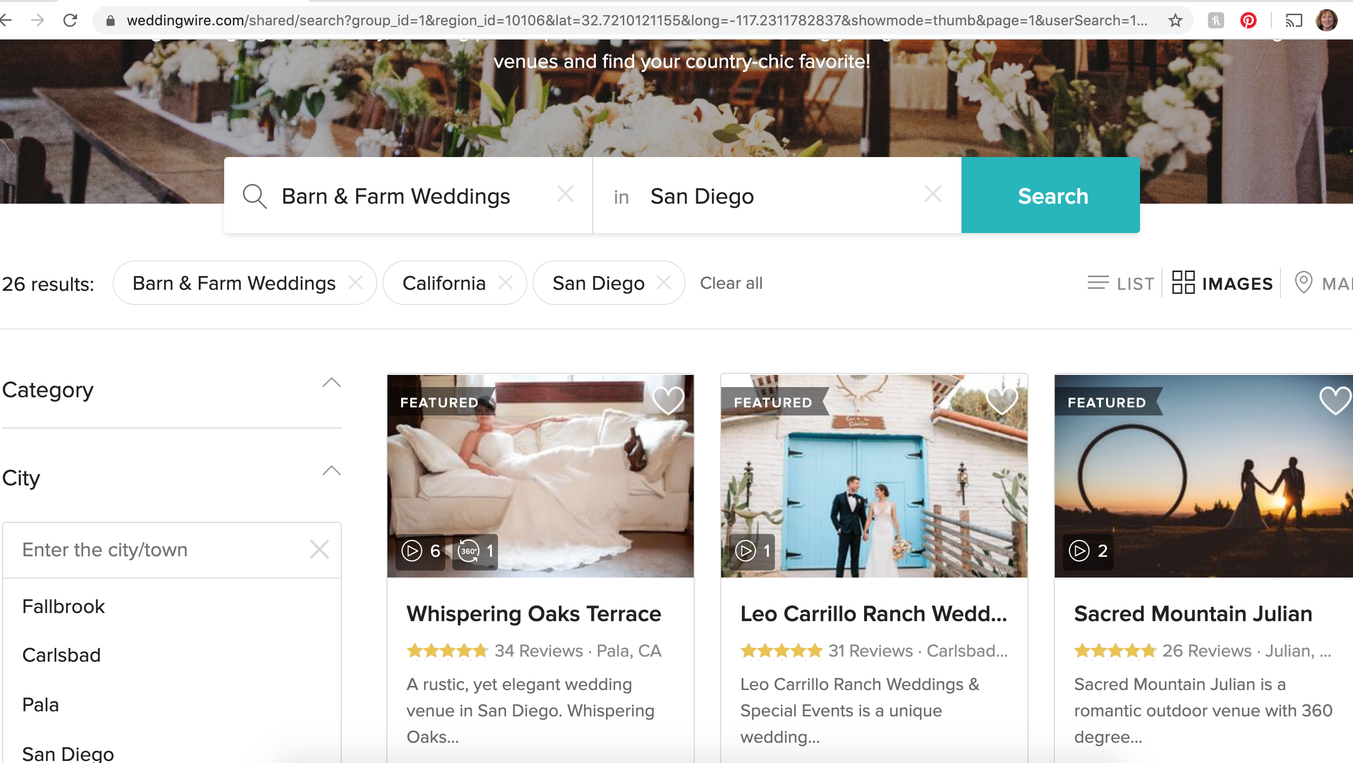
Wedding Wire: Barn & Farm Weddings, 26 hits
ILLEGAL VENUES

Slide 11
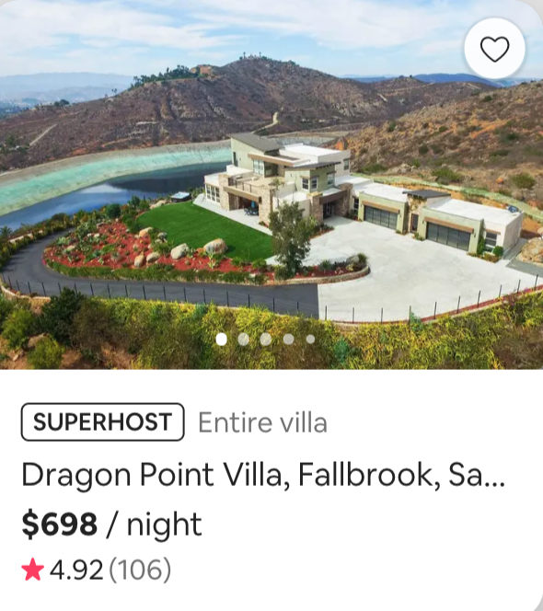

Wedding Chicks promotes Airbnb wedding
ILLEGAL VENUE
Dragon Point Villa
Airbnb #10139229

Slide 12
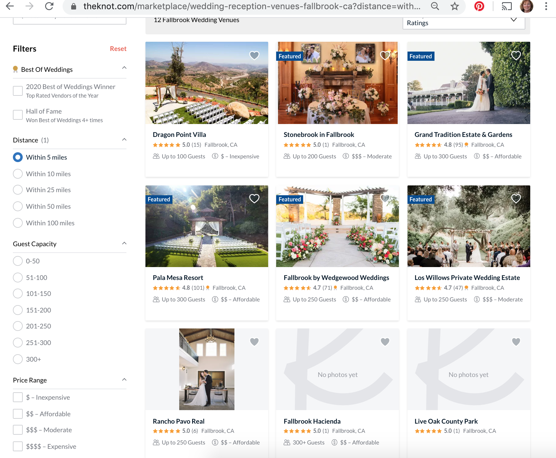
THEKNOT: Fallbrook Weddings
ILLEGAL VENUES

Slide 13
Illegal Venues in North County
Garden of Light, Bonsall
Quail Haven Farm, Bonsall
The Fire Garden, Bonsall
The Rustic Oak, Fallbrook
Morning Song Farm, Fallbrook
Dragon Point Villa, Fallbrook (MUP in process)
White Horse Ranch, Fallbrook
Rancho Pavo Real, Fallbrook
Stonebrook, Fallbrook
Ultimate Serenity, 2808 Lakemont Drive, Fallbrook
The Slate Barn, Vista
Circle Oak Ranch, DeLuz
Enchanted Forest, DeLuz
Pitchouline Events, DeLuz
Fallbrook Hacienda, Rainbow (MUP in process)

Slide 14
Illegal Venues in North County
The Hideaway, Ramona
The Condor’s Nest, Pala
The Secluded Garden, Pala
Whispering Oaks, Pala
Airbnb #7039861, Escondido
Lilac Canyon Estate, Escondido
Melrose Ranch, Escondido
Shadetree Gardens, Escondido
Hazy Meadow Ranch, Lakeside
Sea Breeze Organic Farm, San Diego
Secret Garden, Rancho Santa Fe
Airbnb #23767399, Rancho Santa Fe

Slide 15
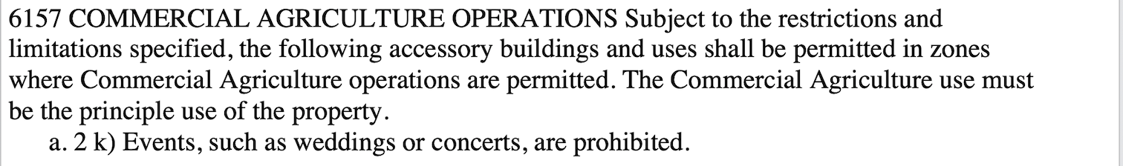
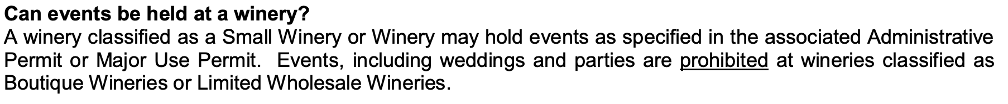
Illegal Venues, Valley Center, North cty
Eden Oaks Ranch
Bella Terra
Hacienda del Sol
Serenity Oaks Ranch
Broken Rock Ranch
Willow Creek Ranch
Keys Creek Winery
Sunshine Mountain Vineyard
Hill Top Winery
….plus many more in San Diego County….

Slide 16
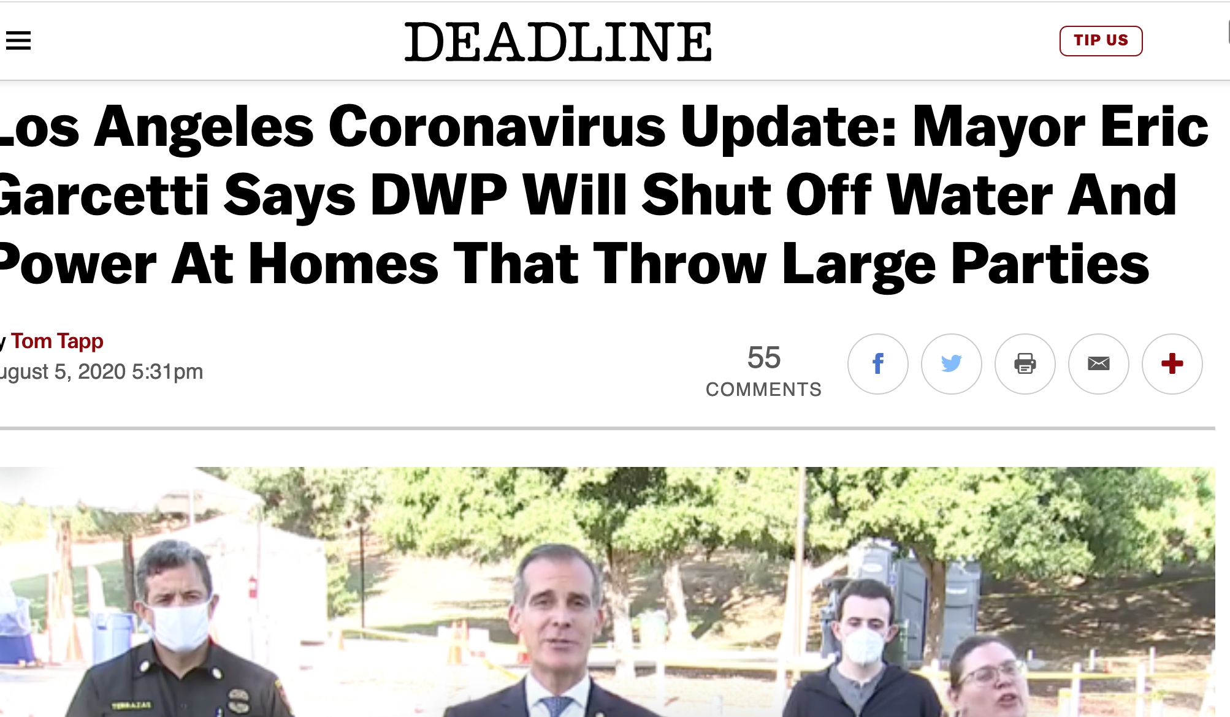
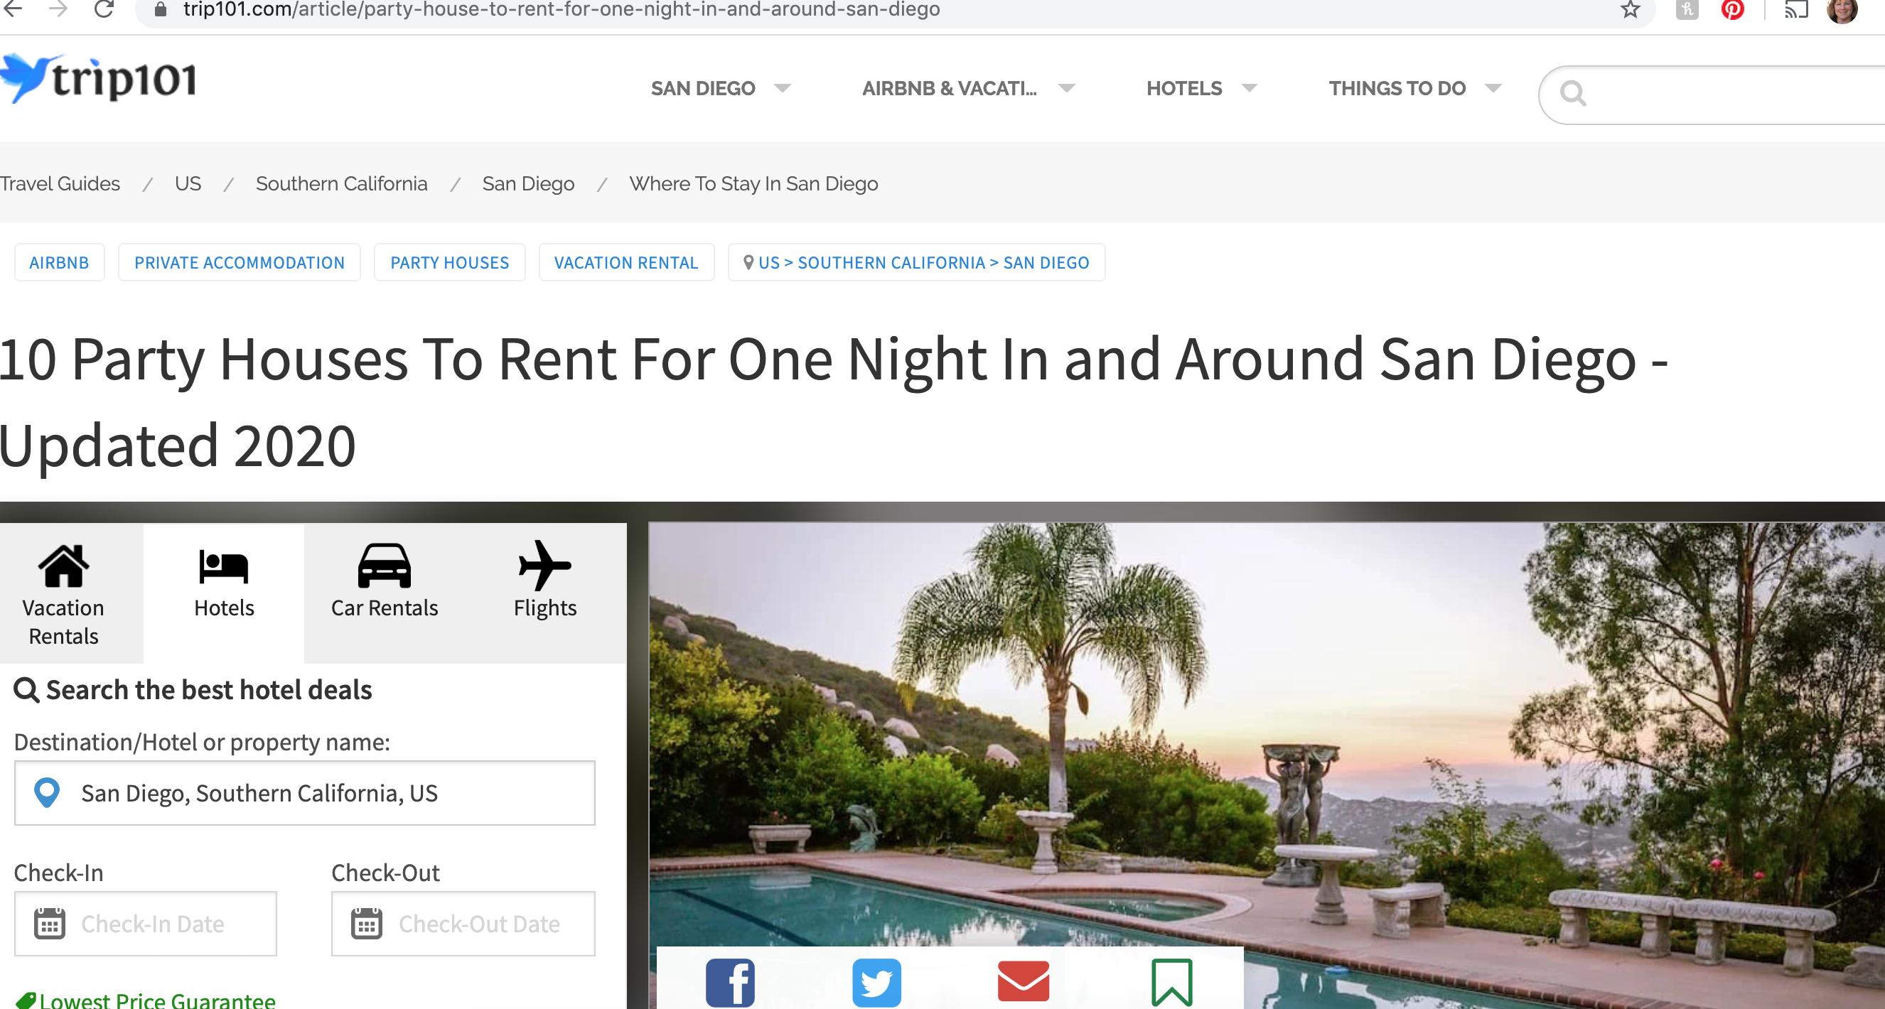
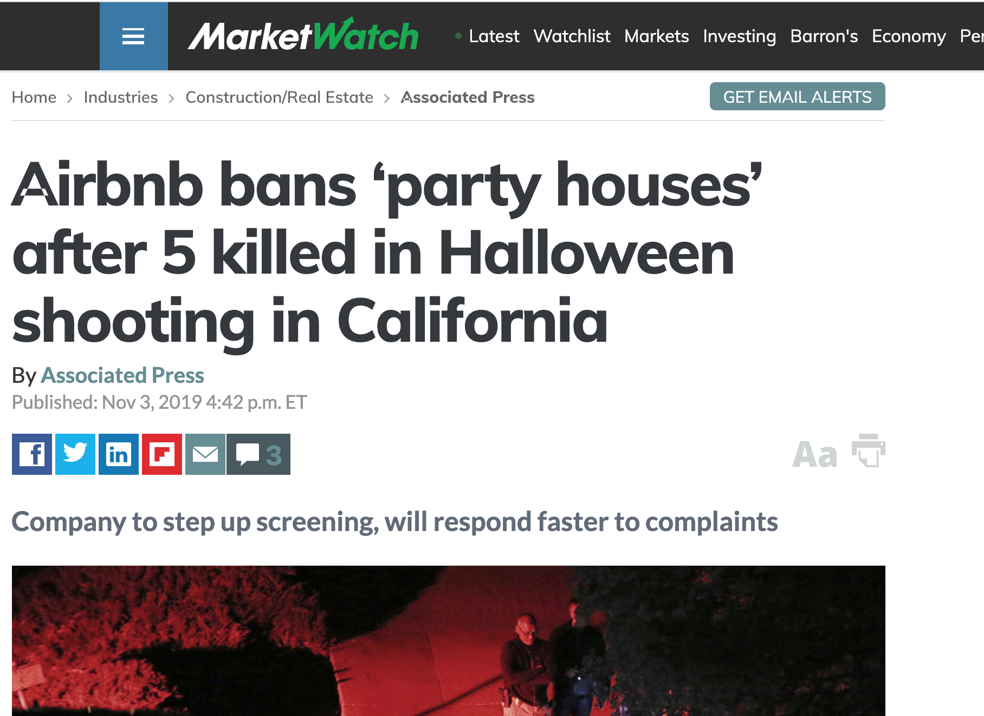
PARTY HOUSES ARE INCREASING AND INCREASINGLY DANGEROUS

Slide 17
SOLUTIONS
Direct brides, planners, public to legal venues
  Create list of San Diego County legal venues for large events and weddings
  Educate on the importance of MUPs
  Encourage booking platforms to add an MUP field and ban repeat offenders
Communicate to brides, planners, public, government
  Negatives and RISKS generated by booking party houses/illegal venues
    cancellations, loss of deposit, lawsuits, parking/traffic, septic/water, safety/fire, public health (COVID)
    Encourage wedding/event planners’ professional associations to commit to legal venues
    Clarify MUP info and educate property owners on what they cannot do without an MUP

Slide 18
SOLUTIONS
Offer neighbors assistance shutting down party houses
  Review locations with multiple noise complaints (10+/year?), Red Flag for special handling
  Create a fully digital complaint process, letters from County, drone shots of weekend parties
  2808 Lakemont Drive as test case, review records for policy ideas
Repeat offenders/Red Flagged Illegal Venues:
  Create digital logs w/camera/noise feeds on neighbor’s properties
  Fines, penalties, liens, lawsuits, tow cars, turn off water/power
  List house as nuisance house (similar to drug houses)
  Force owners into MUP process with ZERO events during the process

Slide 19
CHALLENGE FOR COUNTY: ILLEGAL VENUES
Protect County residents from illegal venues/party houses
  Fire, traffic, parking issues, water quality, COVID transmission
  Decline in property values (and tax revenues), quality of life
  Loss of income for legal venues with MUPs and restaurants
  Protect County from lawsuit risk related to illegal venues

Slide 20
WE LOOK FORWARD TO WORKING WITH YOU!
TERESA PLATT
TeresaPlatt.com@gmail.com
760-468-2025
Sept 11, 2020

