Slide 1
Fallbrook Golf Course
A southern california gem
UnDER THREAT?
…or UNDER CHANGE?
Jan 30, 2016
updated March 2, 2016

Slide 2
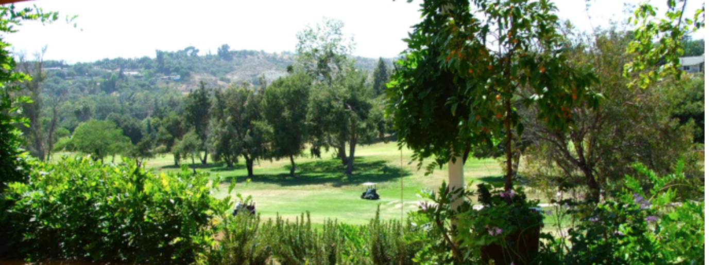
Gorgeous gird valley picture

Slide 3
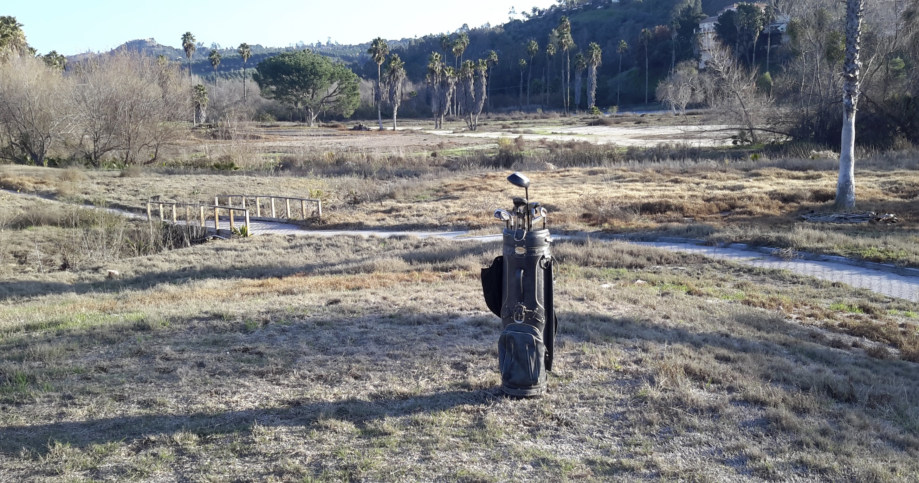

Slide 4
Agenda
Owners of the Fallbrook Golf Course
Army Corps of Engineers (ACE)
County Parks and Recreation
County Planning and Development, Discretionary Projects Group
Elected Reps
  Duncan Hunter’s office
  Bill Horn’s office
  Fallbrook Community Planning Group (FCPG)
Fallbrook Land Conservancy (FLC)
Save San Luis Rey Downs
Save Fallbrook Golf Course Steering Committee
Notes:
Steering Committee: Dolly and Larry Harty, Joan and John McConnell, Scott and Miriam Morel, Maureen and Larry Mitzner, Bill Geffeney and Teresa Platt

Slide 5
Today’s Agenda
Save San Luis Rey Downs
  Jon Frandell
Fallbrook Land Conservancy
  Will Shakespeare, Vice Chairman
Save Fallbrook Golf Course Steering Committee
  Joan McConnell and Teresa Platt
Notes:
Steering Committee: Dolly and Larry Harty, Joan and John McConnell, Scott and Miriam Morel, Maureen and Larry Mitzner, Bill Geffeney and Teresa Platt

Slide 6
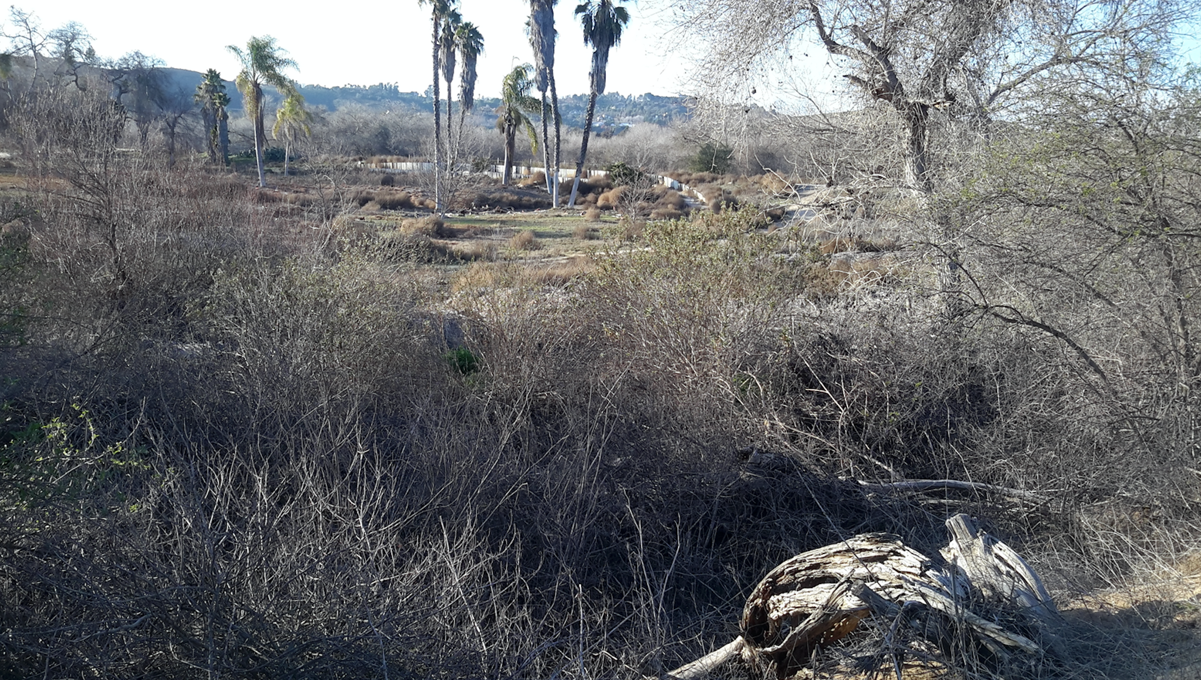

Slide 7
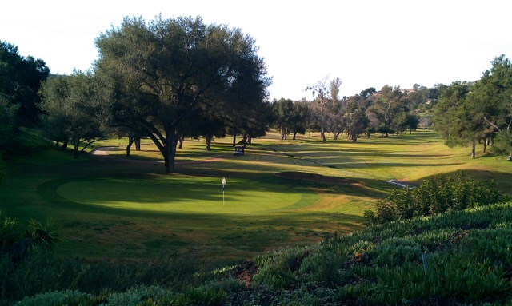

Slide 8
SaveFallbrookGolfCourse.com
Established January 21, 2016
Around Dolly and Larry Harty’s kitchen table
Larry and Maureen ”Mo” Mitzner
Joan and John McConnell
Scott and Miriam Morel
Bill Geffeney
Teresa Platt
2 webmasters: Roy Batchelor and Simon Ward
updated March 2, 2016

Slide 9
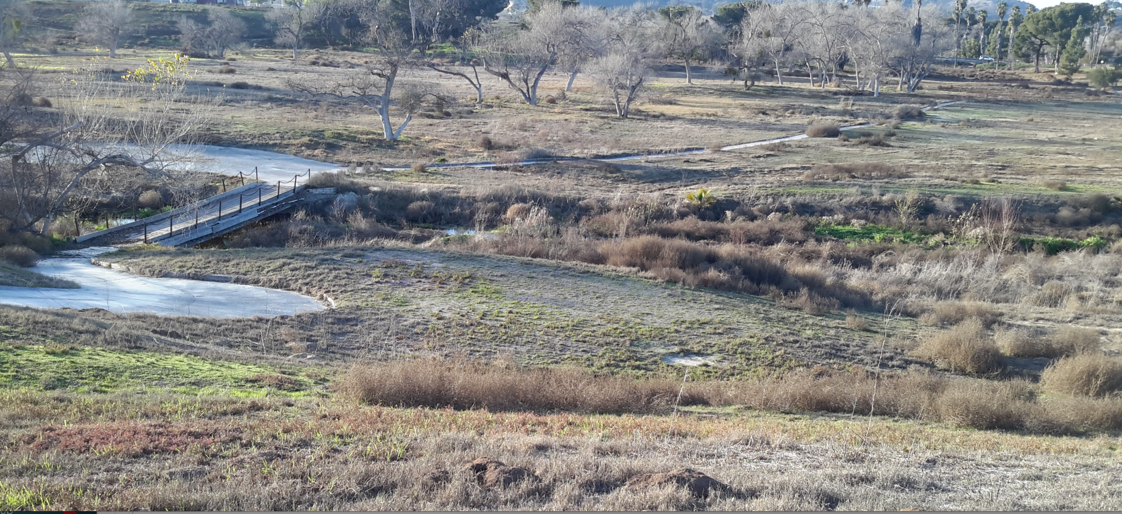

Slide 10
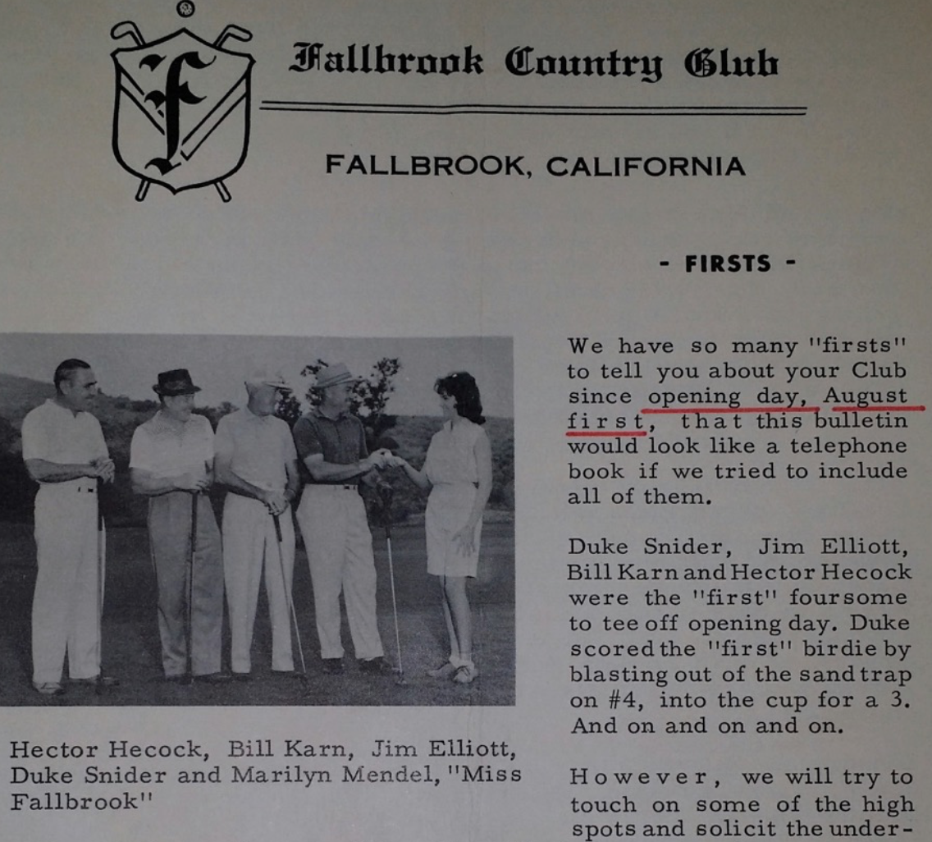
Fallbrook Golf Course/Club
18 hole par-72 golf course, August 1, 1962
116 acres on two legally-described parcels (Parcels 1 and 2) which are made up of 9 Assessor Parcel Numbers (NOT 9 parcels).
This distinction is important in that it means that it would be VERY difficult, it not impossible, to subdivide this property. Experts in the field have cautioned that such a process, if attempted, could require a decade or longer and there would be no assurance of success. Therefore, this property is NOT suitable for subdivision for recreational housing or mitigation banking purposes.
Plot map: www.sangis.org
Updated March 2, 2016

Slide 11
Fallbrook Golf Course/Club
Fallbrook Golf Course, Inc
Jack Lamberon says it is owned by Lamberson Family Trust/sole stockholder
  Jack Lamberson, corporation’s comptroller; Chairman, Board of Directors
    There is no Lamberson Family. LFT Investments, Inc., incorporated in Nevada, is the sole stockholder of Fallbrook Golf Course, Inc, incorporated in California 2011.
FSBO for 2 to 3 years
  $4.5M (was $4.25M)
    for mortgage + improvements + expenses ($1.6M “pumped in”)
      Jack later stated that $900,00 was spent on improvements, balance was down payment.
    Updated March 2, 2016

Slide 12
Whoops! Did we just lose half the course?
LAMBERSON:
  Back nine closed to play Feb 1
  Front nine’s 53 homeowners: don’t worry, committed to 9-hole course
2013: 20 courses open to 180 closures
  9 hole courses represent 57% of total. [Edsforth 2013]
  LAMBERSON:
    “The appraisal of it as a golf course is between $1.8 and $2 million…”
    “…as a home development site it appraises at $4.8 million, because the money is not in the golf course.”
    “The County, I’m sure, would like to have houses on it for the tax revenue.”
                Village News, Jan 26, 2016

Slide 13
Fallbrook Golf Course/Club
Per Jack Lamberson, there are 4 offers to buy course:
  Buyer/Escrow #1 to close 2/15:
    Back nine (36-42 acres). Potential buyer is Don Ross of EarthBalance of Florida, “closed for mitigation,” sold to “conservation land group for mitigation,” sold to “mitigation bank”
    LAMBERSON: If escrow does not close, “put into a set-a-side, subdivide or farmed at owner’s discretion." Closed to play Feb 1
  Buyer #2: 18 holes, offer too low
  Buyer #3: 18 holes, refused to post non-refundable deposit
  Buyer #4: 18 holes, balked at increase to $4.5M.
    W/take balance if Buyer #1 closes escrow on back nine 2/15
    Create 9-hole golf course on front nine (but price suggests development)
    Updated March 2, 2016

Slide 15
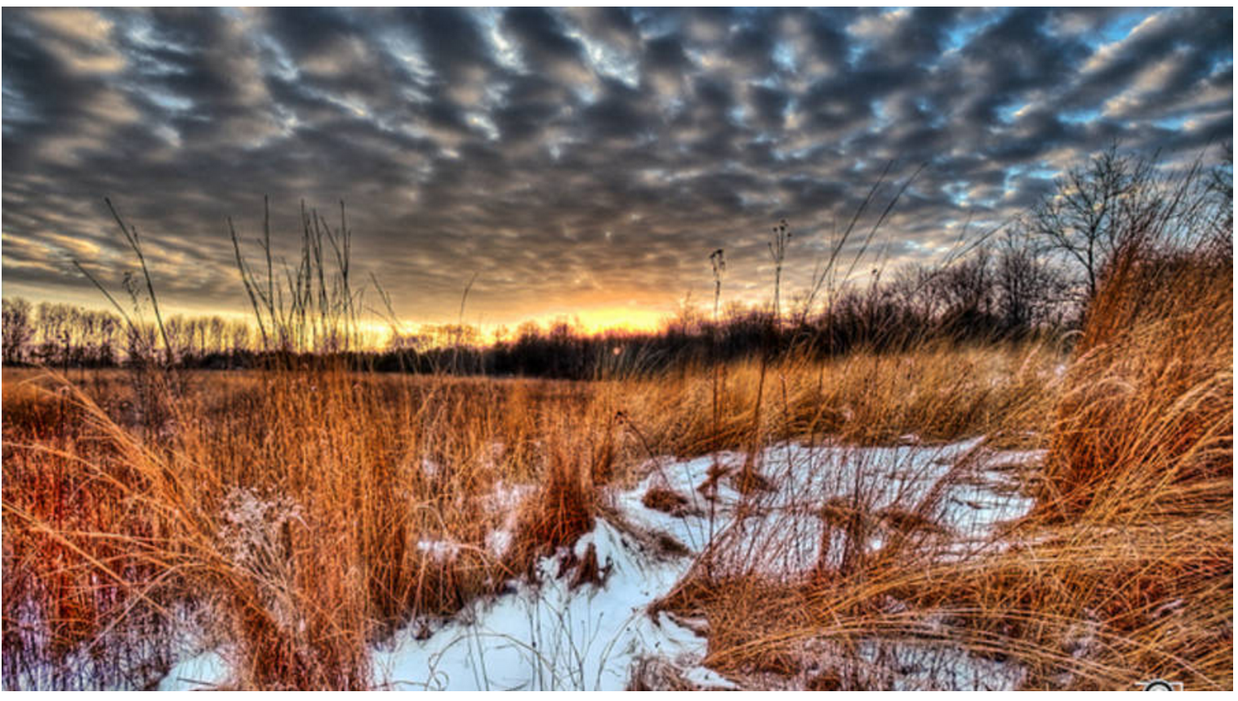
Formerly Larch Tree Golf Course, Dayton, Ohio
Notes:
BEST CASE DAYTON, OHIO, FORMERLY Larch Tree GOLF COURSE.
http://www.marketplace.org/2015/01/12/sustainability/old-golf-courses-become-new-kind-wilderness

Slide 16
Wetlands mitigation banking
1983: FWS Guidance (not law/CWA):
  support establishment of mitigation banks
1992: 46 banks permitted
1993: EPA and Corps (primary fed agencies responsible for implementing Section 404 program of the Clean Water Act)
  issue interim Banking Guidance (not law, not CWA).
1995: EPA, Corps, FWS, NOAA’s NMFS, USDA’s Natural Resources Conservation Service:
  release final Federal Guidance on the Establishment, Use, and Operation of Mitigation Banks
TODAY: $3B, 2,000 mitigation banks nationwide

Slide 17
Mitigation banks in US

Slide 19
Mitigation banking on the back nine
Golf course allowed to go fallow, to seed and weeds
Buyer places conservation easements on the land
  Restoration to riparian areas and wetlands
FWS, Corps approve sale of mitigation credits
Mitigation credits sold for cash to
    Big Government agencies and Big Developers
    Releasing them from any culpability wetlands damage
    Related to Highway 76 expansion and damage to SLRRV
    SDG&E for transmission line installations, Camp Pendleton
No limit on what gov’t agencies will pay, it seems
  $150,000 to $500,000 per acre est [Wildlands mitigation bank, kpbs.org]
  Ecosystemmarketplace : SD County: $120k to $900k/acre, $380k/acre average

Slide 20
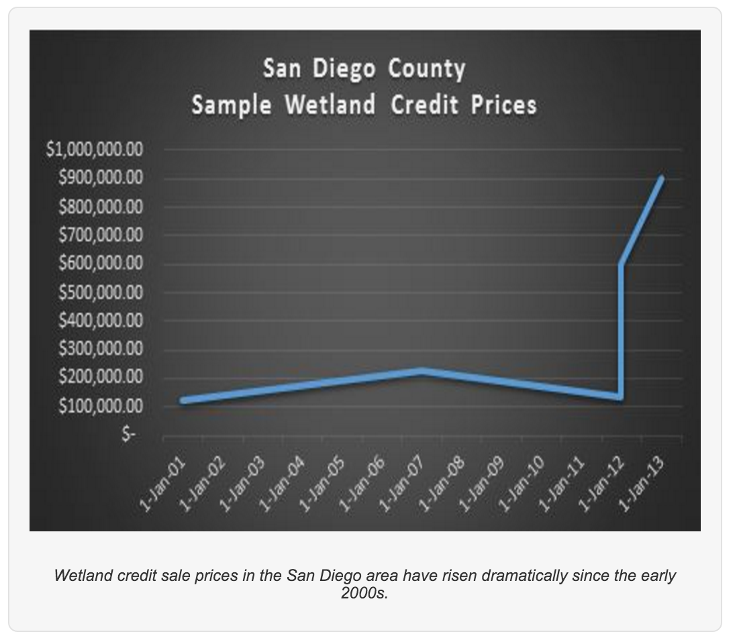

Slide 21
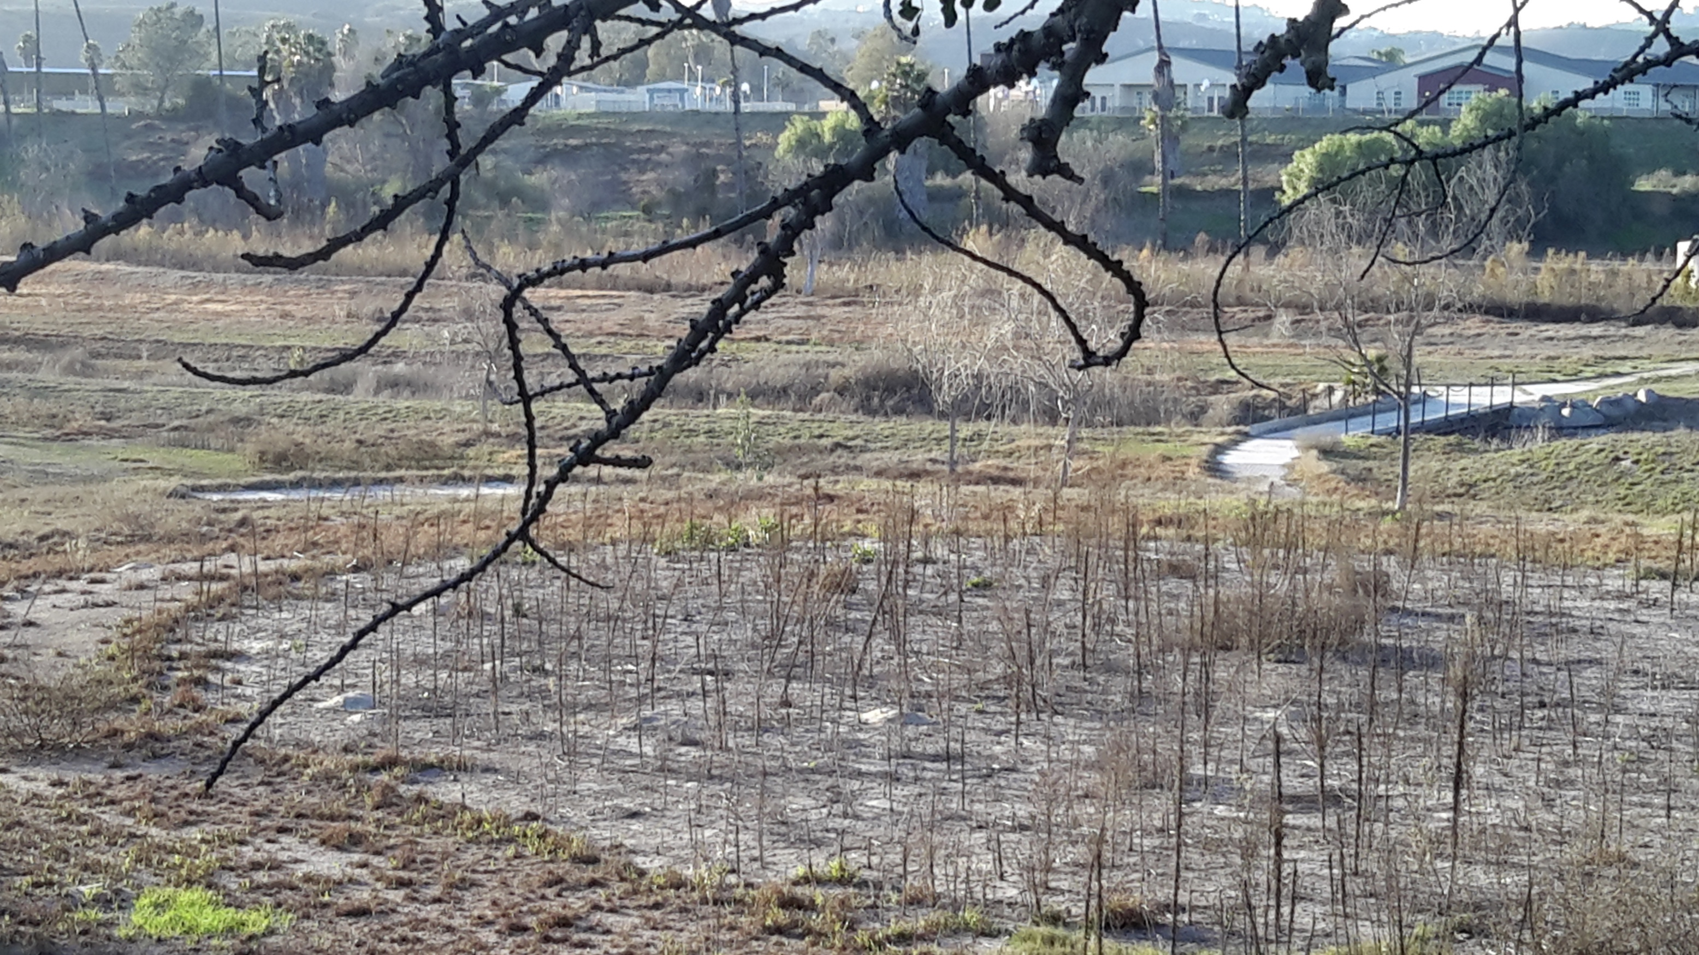
Notes:
WORST CASE: Think San Luis Rey Downs Golf Course, now the San Luis Rey Downs Weed Patch, Think San Luis Rey Downs Golf Course
now the San Luis Rey Downs Weed Patch
surrounded by thousands of angry and disgusted Bonsall neighbors
surrounded by thousands of angry and disgusted Bonsall neighbors

Slide 22
Worse case scenario: SLRD GC >>> FBGC
Fallbrook residents and local government will be left with
  negatively impacted view sheds
  a weedy fire hazard in the middle of residential development
  increased fire insurance premiums
  decimated property values, 30% on 1000 homes ($500k average) = $150M lost equity
  a vastly diminished tax base
  fewer recreational and job opportunities
Historic Gird Valley will host an eyesore along Gird Road

Slide 23
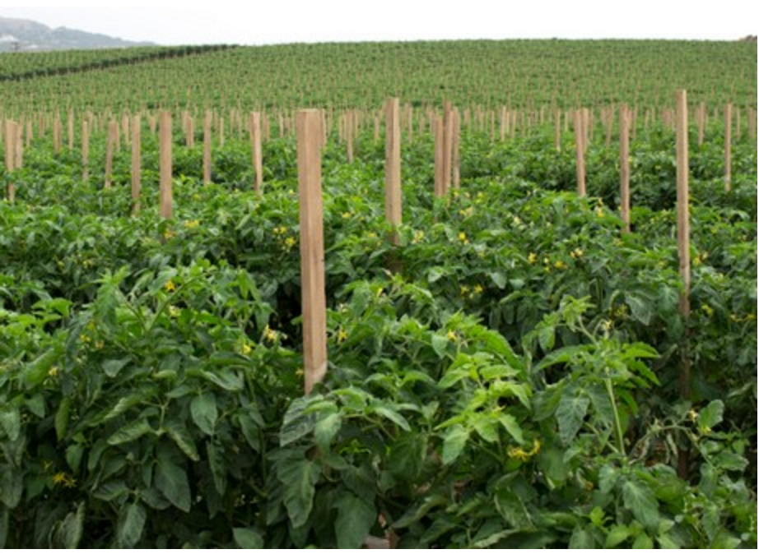
Case Study: Singh family tomato farm
Wildlands of Sacramento purchases 56 acres:
“…setting the river free…” ”...allowing dense riparian vegetation, including willows and cotton woods …to colonize the river, shade the river.”
“...river will be able to meander and spread out into the flat agricultural lands...”

Slide 24
Singh Farm, SLR River Valley
Wildlands mitigation bank buys 56 acres from Singh tomato farm
  Paid a premium per acre, actual price $60k/acre = $3.36M
  Expenses over several years, 5 years?, 56 acres x $125k to $160k/acre = $7-9M
    Moving dirt, restoring native plants
    Paperwork: Permitting process with FWS and Corp
  Estimate $7-9M total in expenses
  Mitigation credits permitted, ready for sale
  Payday: Mitigation credits sold to developers and gov’t agencies
  Wildlands: 56 acres of mitigation credits @ $150k to $500k per acre
    $8.4M to $28M [kpbs.org]
    Less $7-9M invested = $1.4M to $19M in profit
    Updated March 2, 2016

Slide 25
Mitigation bank deals deliver to
Land seller:
  $$$ premium/acre
Developers and gov’t agencies (taxpayer dollars):
  Mitigation credits @ $150k to $500k/acre (Singh farm in SLRRV)
Community:
  More wetlands – sometimes!
  Loss of farm land, possibly developed or recreation land
  Diminished tax base
  In SoCal, increased fire hazard + insurance premiums

Slide 26
Mitigating the damages from mitigation banks
Conversion to mitigation bank, commercial or residential development
  Require County Discretionary Use Permit
  Federal agencies REQUIRED to COORDINATE w/locals
URGE San Diego County and Fallbrook Planning Group
  Exert their power: COORDINATION
  Proceed with caution, weigh pros and cons
  Q: Fallow developed recreation land in pursuit of unlimited taxpayer $$$?
  Q: Allow the free market to buy depressed assets and revitalize?
URGE Congressman Duncan Hunter
  Review the CWA programs that are creating a mitigation bank gold rush

Slide 27
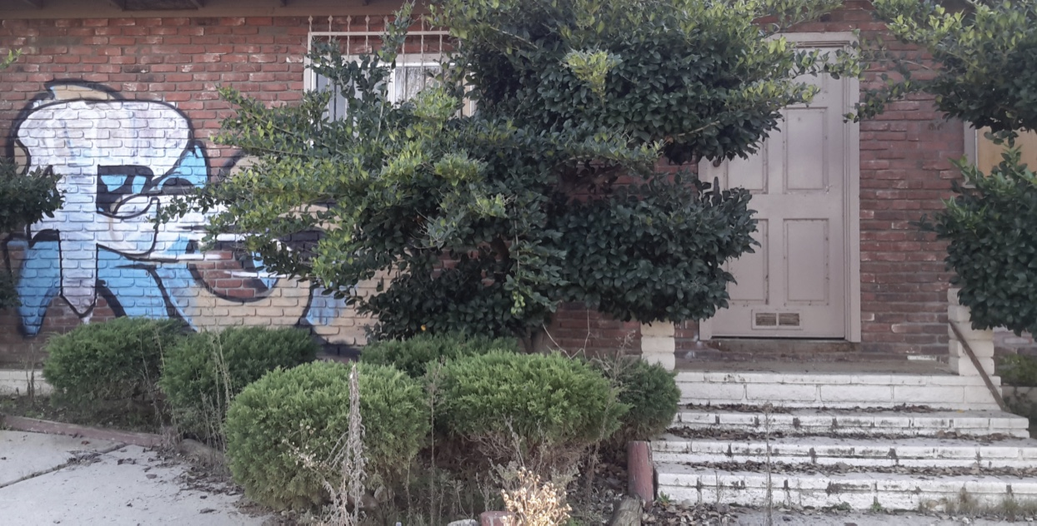
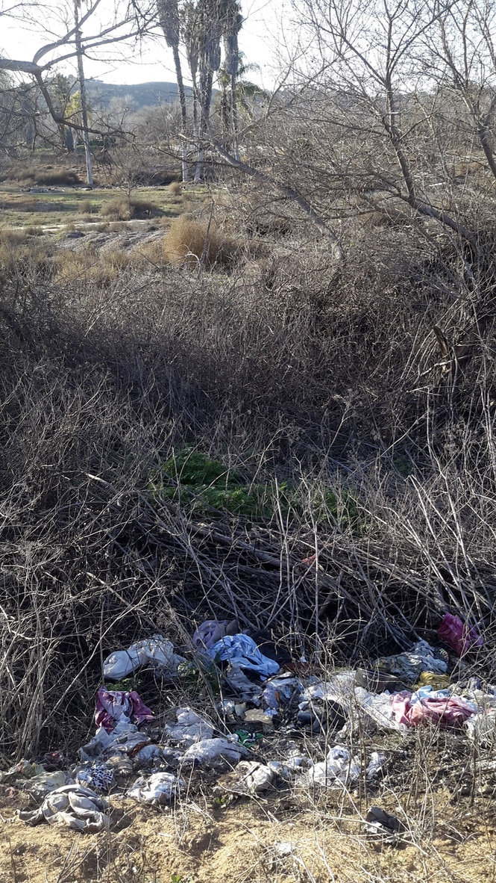
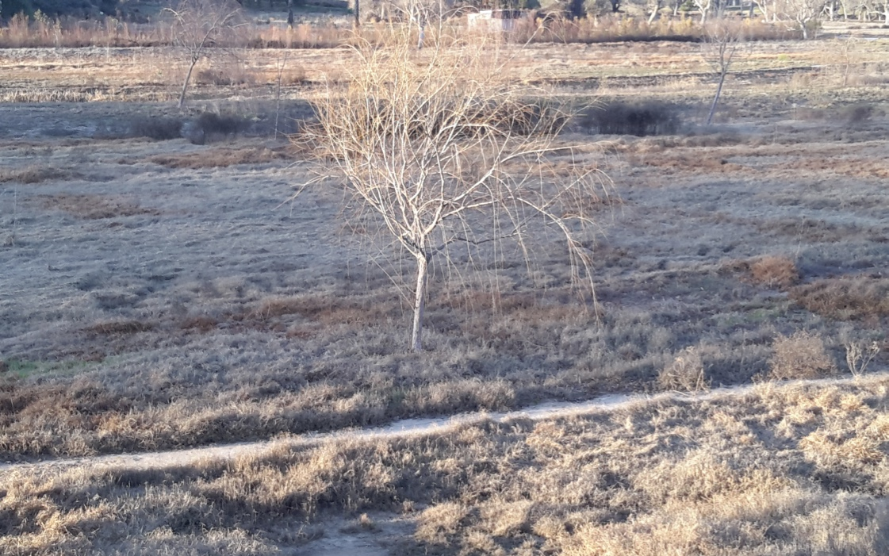
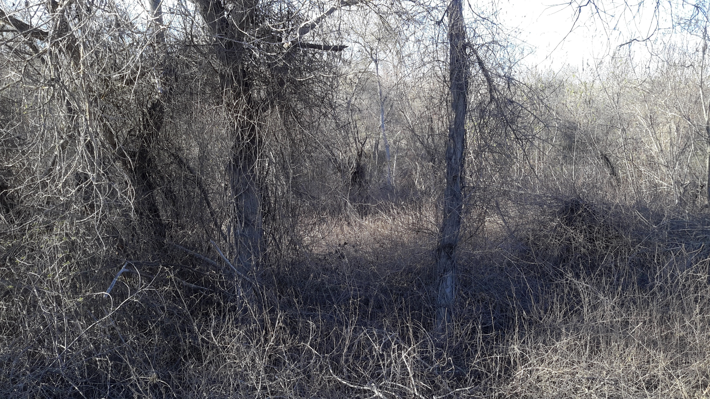

Slide 28
Formerly Larch Tree Golf Course, Dayton, Ohio
Notes:
BEST CASE DAYTON, OHIO, FORMERLY Larch Tree GOLF COURSE.
http://www.marketplace.org/2015/01/12/sustainability/old-golf-courses-become-new-kind-wilderness

Slide 29
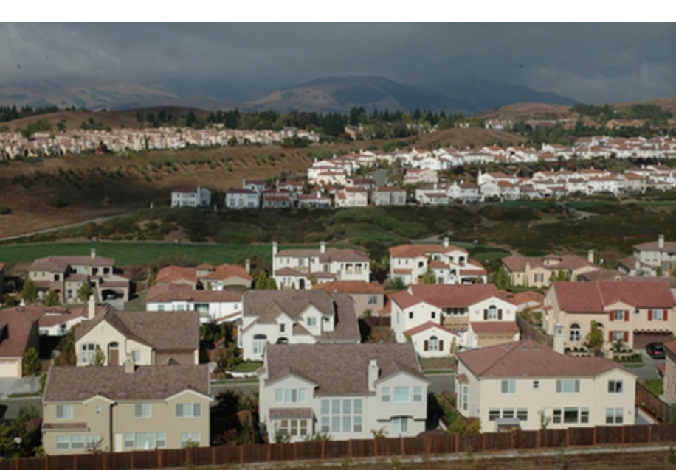

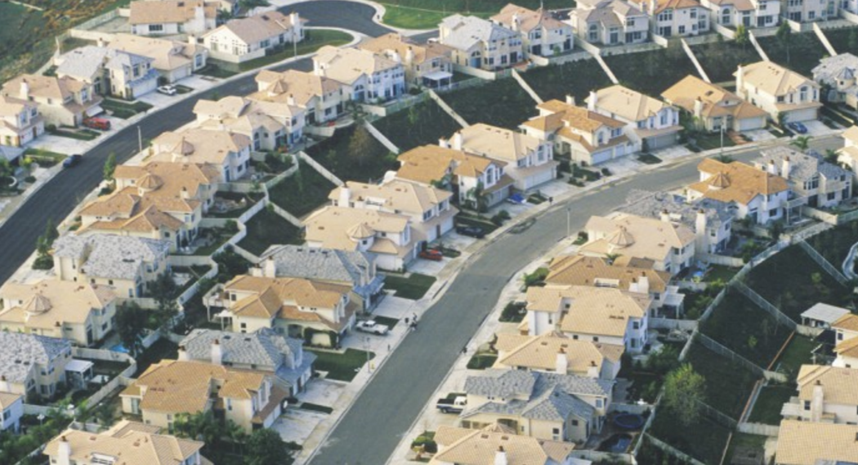
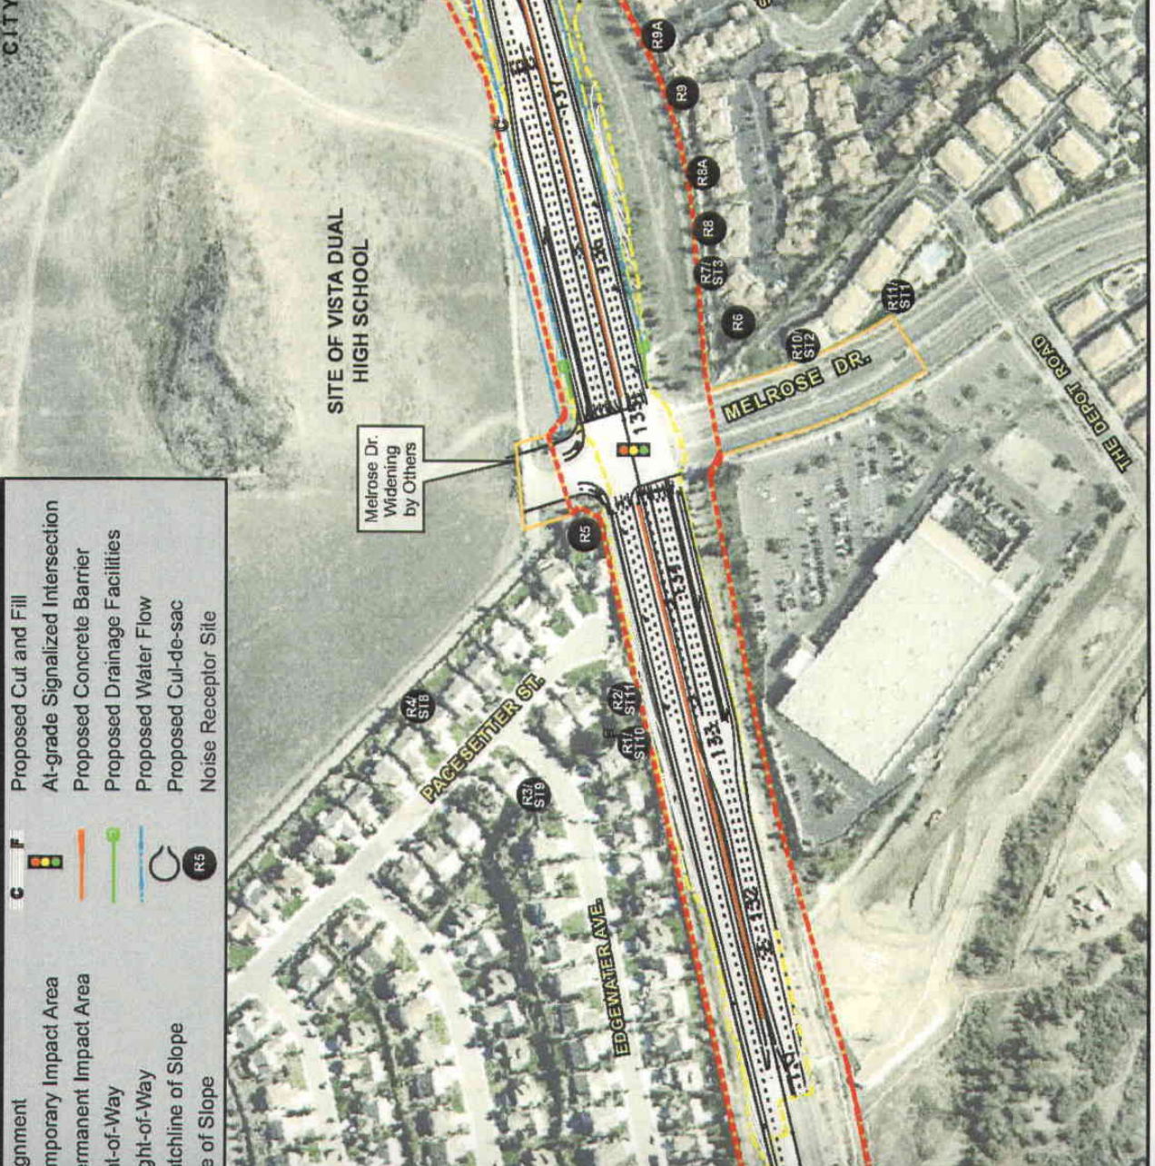

Slide 30
SaveFallbrookGolfCourse.com
SaveGirdValley.com
SaveFallbrookGolfCourse.com
SaveFallbrookGolfCourse.com

