Slide 1

Bonsall Unified School District
(BUSD) and Measure EE
Teresa Platt, Brad Jordan
SaveGirdValley.com
October 31, 2018

Slide 2
What is the issue?
BUSD put Measure EE on Nov 6 election, $38M bond secured by your property taxes, for Phase I of III for building 1,500-student high school and performing arts center
Why is SaveGirdValley.com involved?
The site chosen—1.1 miles from northernmost edge of the District on Gird Road—impacts Fallbrook’s Gird Valley

Slide 3
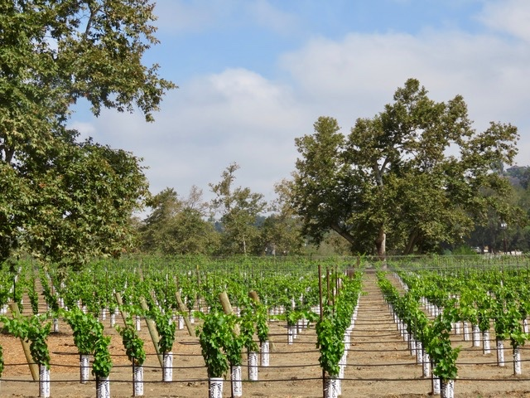
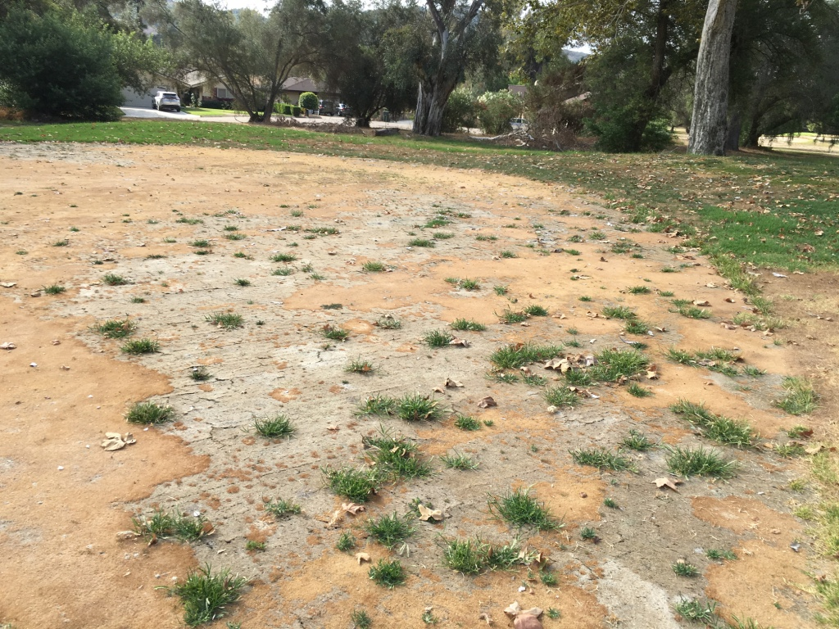
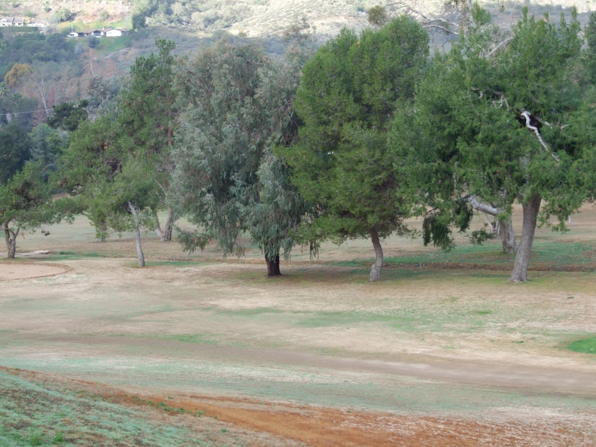
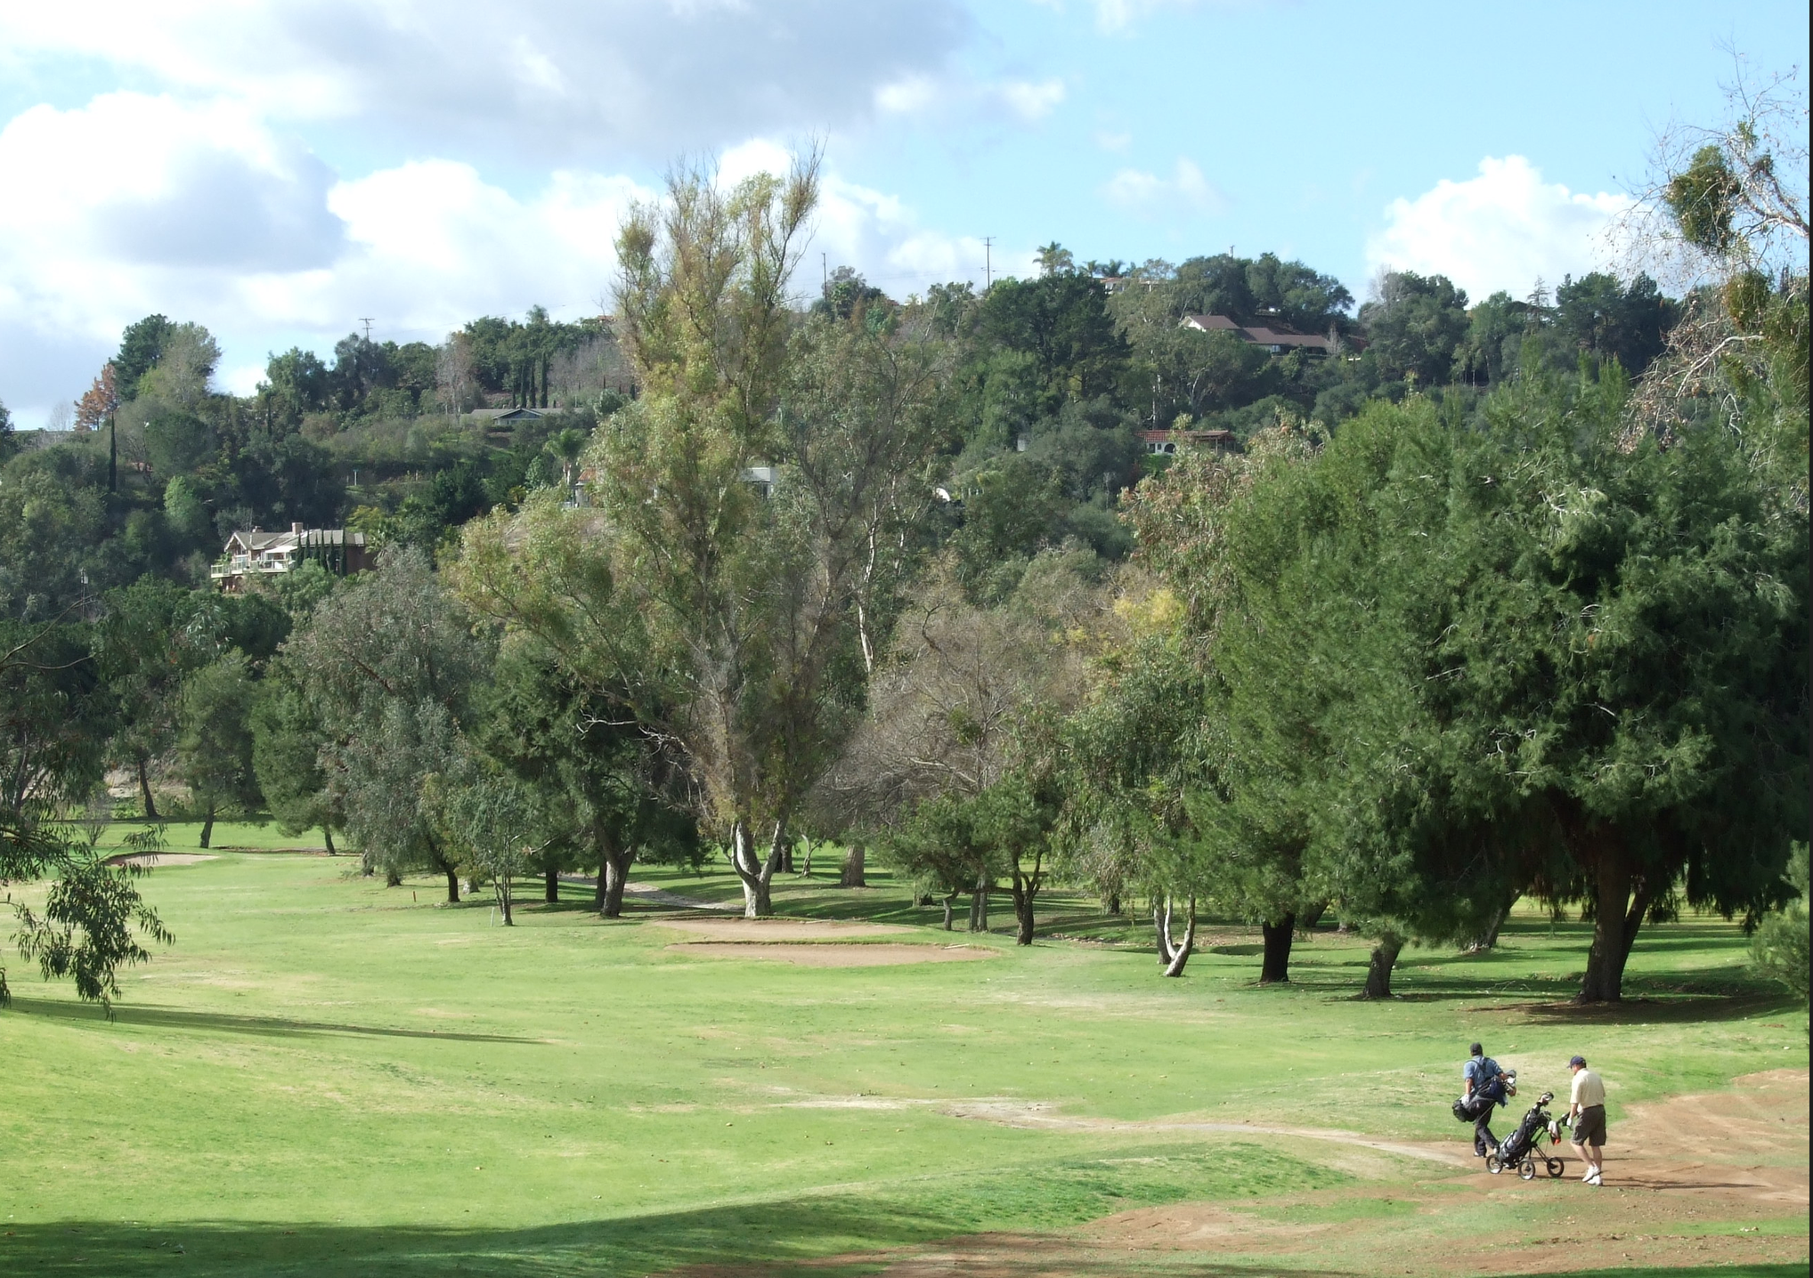

Slide 4
WE DID OUR RESEARCH AND DISCOVERED…
1) Measure EE: Attempt #6 to build a high school in Gird Valley
2) No justification for another new high school in the area
3) BUSD is financially challenged

Slide 5


Slide 6
1) Measure EE is Attempt #6
Measure EE is Attempt #6 since 1978 to build a high school
  North of the 76, in Fallbrook’s Gird Valley
    adjacent to Golf Club of California
    very high wildfire zone
  1.1 miles from northernmost edge of the District
    Inconvenient, not centrally located
Measure EE, a $38M bond measure for a high school, is actually for just Phase I of III
Expect bond measures #7 and #8 to follow for $100M+ (double that to include interest) to build a 1,500-student high school
This is slow growth Bonsall/Fallbrook so expect Measure EE to benefit and help trigger sprawl development

Slide 7
2) No justification for another new high school
REALITY: Enrollment at BUSD is NOT growing
  i. 2016: BUSD projected a 120% increase in high school enrollment by 2020
  ii. REALITY: Lots of choices, low BUSD retention rates, enrollment declined in 2018
  iii. 2021: State of CA predicts long term declining enrollment trend starting 2021

Slide 8
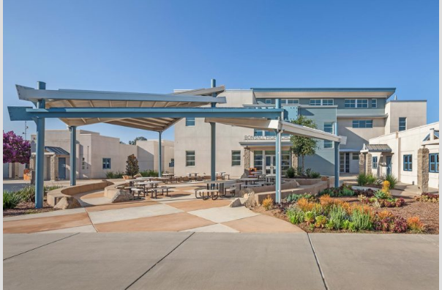
2) No justifications for another new high school
B) Reality: BUSD Has Adequate Housing/Classrooms
2012 unification (expanded from K-8 to K-12, Lilac Hills Ranch funded): BUSD said it could accommodate a small high school of 500 to 600 students at Sullivan Middle School Campus
Sept 2016: BUSD borrowed, built and opened state-of-the-art two-story high school with 10 classrooms, two high school quality labs
Nov 2016: $58M Measure DD, BUSD proposed high school for 1,500 and performing arts center (LHR funded), Failed Attempt #5
June 2018: BUSD’s high school graduating class was just 57 students
Nov 6, 2018: $38M Measure EE (LHR funded), Attempt #6

Slide 9
2)No justification for another new high school
B) REALITY: BUSD Has Adequate Housing/Classrooms

Slide 10
2) No justification for another new high school
Reality: 7,798 housing units in District (Cal-Muni)
  generating 344 HS’ers in 2018-2019 at BUSD
    +10% (780 units) = 34 students
    +20% (1,560 units) = 69 students
    +30% (2,339 units) = 103 student
Reality: Strong competition, overcapacity in area
  32 public (including charter schools) and 15 private high schools ringing BUSD
  Fallbrook Union High School (capacity 3,000+) enrollment down 30%
  Online learning moving education from brick and mortar to digital age
  GreatSchools.org lists 118 high school options within 15 miles of 92003
Reality: California predicts long-term declining trend as of 2021 (SDUT)
    “…declining birth rates and lower in-migration rates will send school enrollment on a continuous decline, according to state enrollment projections.”

Slide 11
3) BUSD is financially challenged
Deficit spending for over seven years
BUSD reserves declined from 30.8% to +/-3% legal limit
Fall 2017, 2018: BUSD borrowed $2.7M for operating expenses
BUSD’s liabilities $55.6M (Audit 2017)
  -incl. $5.5M Capital Appreciation Bonds w/$18.4M payoff after 2030 (2005 Prop C $17M)

Slide 12
3) BUSD is financially challenged, contd.
Dec 2016: After Measure DD failed Nov 2016, BUSD approved $20M lease-leaseback at 14.6%/$300k/month (no notice, not competively bid, legal challenge resulted in its cancellation)
Before passing a bond, BUSD has spent hundreds of thousands $$$ on a Draft EIR + $450K of design work related to Gird Road site
BUSD debt per student: $13,700 (CA average $8,800)
2018: All three of SD County School Districts that made the State’s Fiscal Red Flag List are in North County: Oceanside, San Marcos, BUSD

Slide 13
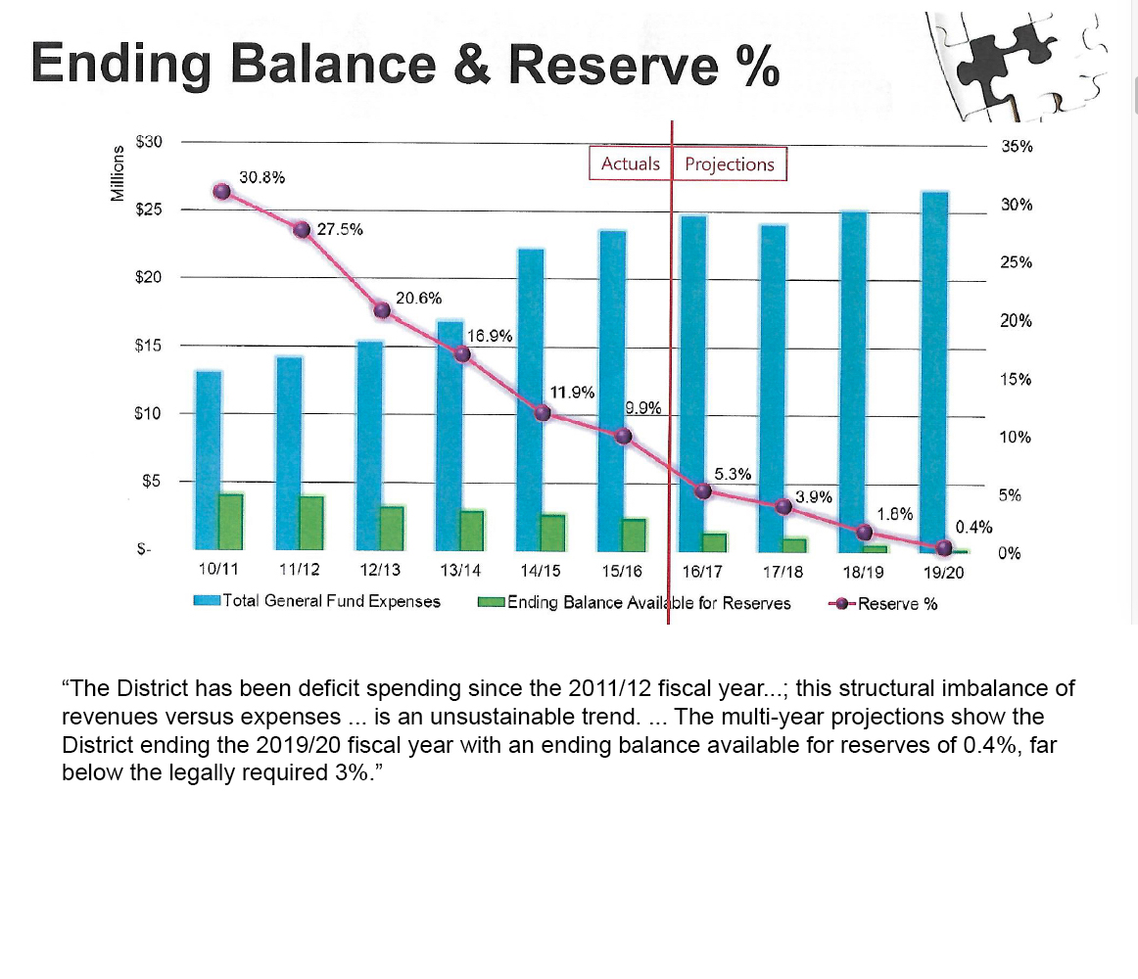
BUSD 2017 presentation.

Slide 14
What can you do to help?
Vote No on Measure EE
BUSD Board Election:
  Four-year term
    Vote for Roger Merchat ONLY
  Two-year term
    Vote for Dr. Sylvia Tucker ONLY
Final push before November 6:
  We need your email so we can send you info to share with your family and friends in the District!

Slide 15
Thank you for your time and consideration!
SaveGirdValley.com

Slide 16
What can we do to help local education?
Planning, Utilization of Space, Traffic Reduction, Evac Plans
  Realistically evaluate area competition, capacity and move into digital era
  Create heat map to understand location and density of students
  Create Master Plan with full costs to address full needs over at least a decade
  Efficiently utilize existing space
    Move younger students from SMS to BUSD’s two elementary schools
    Keep current high school (per State, County, FCPG ), in centrally-located complex
  Implement carpooling to reduce traffic and assist with emergency evacuations
Commit BUSD to Fiscal Responsibility
  Reveal Capital Appreciation Bonds in audits
  Include # enrollment, #s on campus daily, capacity (permanent and temp) in audits
  Maintain reserves at 10%+ without more debt
  Sell Fallbrook property per State/County/FCPG’s advice
  Secure grants for safety, security and renovation of tracks (we found 16 grants)
Commit BUSD to addressing lack of transparency
  Create online audio archive for meetings/workshops
  Upload TransparentCalifornia.com data promptly

Slide 17
FYI: SCHOOL SAFETY GRANTS
Bureau of Justice Assistance: A creation of a school threat assessment team and the use of technology for anonymously reporting suspicious activity as it relates to violence in schools. $50 million available. Awards capped at $500,000.
Bureau of Justice Assistance: School safety training and mental health programs for school personnel and students as they relate to violence in schools. $50 million available. Awards capped at $500,000.
U.S. Department of Education: Grants to ensure the health and well-being of students, teach students good citizenship and character, respond to crises, and prevent drug and alcohol abuse. $2,220,770 available for California schools.
School Violence and Prevention Program: $25 million available in grant assistance for training school personnel and students in violence prevention, threat assessment and anonymous threat-reporting systems. Also the grant provides for locks and other security measures as well as coordination with local law enforcement.
COPS program: This grant provides for hiring and training of School Resource officers and responds to specific school safety problems. $905 million already allocated/invested. Each award capped at $500,000.
Drako Cloud Security Grant: Each grant receives one full year of funding for cloud-based Eagle Eye Security Camera Video Management System and associated components. This includes recording services, centralized management, gateways, cameras, necessary networking equipment. Schools can use their existing security cameras and convert their surveillance system to the Eagle Eye cloud-based VMS.
Video Insight: This grant is to help schools attain video surveillance systems. Grants are at $20,000.
Lowe’s Toolbox for Education: These grants are for school building renovations/upgrades, ground improvements such as fencing, and safety improvements. The grants are as much as $100,000.

Slide 18
Safety Grants compiled by Kerry Patterson from following websites
Bureau of Justice Grant: https://www.bja.gov/programs/STOPSchoolViolenceActof2018/STOPSchoolViolenceActof2018FundingOpportunitiesWebinar.mp4 offers 2 different grants
U.S. Department of Education: https://www.ed.gov/news/press-releases/us-department-education-awards-388-million-safe-and-supportive-school-grants
School Violence and Prevention Program: https://www.samhsa.gov/grants/block-grants
COPS program: https://cops.usdoj.gov/grants
Drako Cloud Security Grant: https://www.een.com/american-security-today-apply-today-1000000-drako-cloud-security-grant-for-schools/
Video Insight: https://firstrespondergrants.com/video-insight-surveillancesecurity-software-grants/
Lowes Toolbox for Education: http://toolboxforeducation.com/

